Slide 1



Building Azure Data Resources with Bicep
Frank Geisler

Slide 2
























Frank Geisler MSc. IT
Geschäftsführer, Gründer und Eigentümer
Frank Geisler ist seit 1997 selbstständig, seit 2014 Microsoft Data Platform MVP und hält zahlreiche Microsoft Zertifizierungen
frank_geisler@geislers.net
Tätigkeiten
Microsoft Data Platform MVP
Microsoft P-TSP
Mitglied im Vorstand der PASS Deutschland e.V.
Gründungsmitglied der PASS Deutschland e.V.,
Regionalgruppenleiter PASS RG Münsterland
Autor
Sprecher

Slide 3
Agenda
Infrastucture as Code
What is Bicep
Elements of Bicep
Demos

Slide 4

Infrastructure as Code

Slide 5
What is Infrastructure as Code
Process of automating infrastucture provisioning
Uses descriptive language not imperative
Uses versioning system
Generates always the same result
Infrastructure as part of your deployment process

Slide 6





The IAC Process
Github
Check in
deploy
Check in

Slide 7
Why Infrastructure as Code?
Increase confidence in deployments
Manage multiple environments
Better understand your Cloud Environment

Slide 8
Imperative VS Declarative
Imperative
declerative
Bash / Azure PowerShell
Script has Create Commands
Disadvantages: Scripts become complex to manage
Commands may be deprecated/updated → review of scripts
Json
Bicep
Ansible
Terraform

Slide 9
Imperative VS Declarative
Imperative
declerative
#!/usr/bin/env bash az group create \ --name storage-resource-group \ --location eastus az storage account create \ --name mystorageaccount \ --resource-group storage-resource-group \ --kind StorageV2 \ --access-tier Hot \ --https-only true
resource storageAccount 'Microsoft.Storage/storageAccounts@2019-06-01' = { name: 'mystorageaccount‘ location: 'eastus‘ sku: { name: 'Standard_LRS‘ } kind: 'StorageV2‘ properties: { accessTier: 'hot‘ supportsHttpsTrafficOnly: true } }

Slide 10

What is Bicep?

Slide 11
What is Bicep?
Azure Resource Manager Template Language
Declaratively deploy Azure Resources
Domain specific language
Intended to be easy to understand
Simplified Json Notation

Slide 12
Benefit of Bicep
Simpler Syntax than Json
Modules: Break down large scripts in small chunks
Automatic dependency management
Type validation and Intellisense (Bicep Extension for Visual Studio Code)

Slide 13
BICEP EXAMPLE
param location string = resourceGroup().location param namePrefix string = 'storage‘ var storageAccountName = '${namePrefix}${uniqueString(resourceGroup().id)}‘ var storageAccountSku = 'Standard_RAGRS‘ resource storageAccount 'Microsoft.Storage/storageAccounts@2019-06-01' = { name: storageAccountName location: location kind: 'StorageV2‘ sku: { name: storageAccountSku } properties: { accessTier: 'Hot‘ supportsHttpsTrafficOnly: true } } output storageAccountId string = storageAccount.id

Slide 14



HOW BICEP WoRKS
Tooling of bicep transforms bicep script to Json Script (transpiling)
Azure Resource Manager only undestands Json
Bicep
Template
JSON
Template
Azure
az deployment group create \
--template-file ./main.bicep \
--resource-group storage-resource-group
Template Author

Slide 15
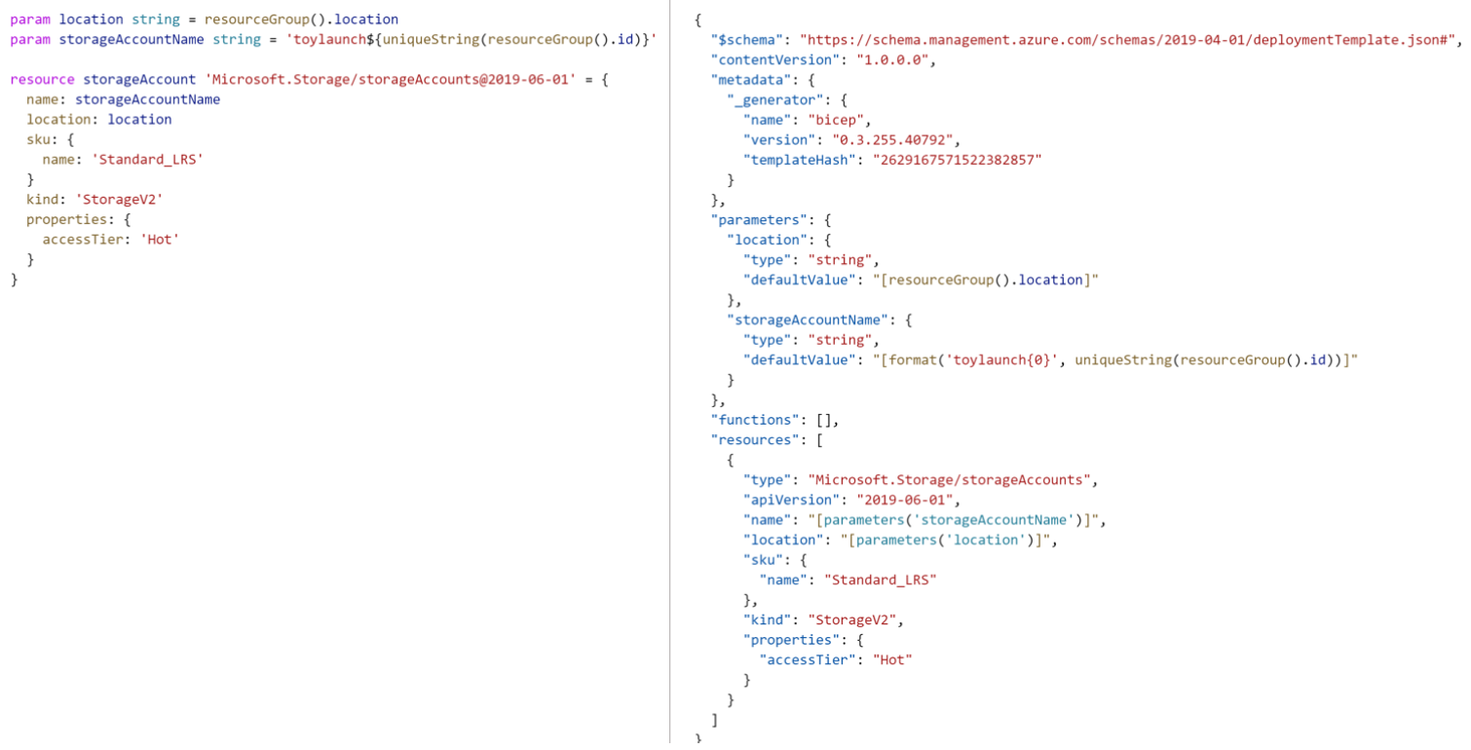
Comparing JSON and bicep

Slide 16
When is BICEP the Right Tool
Azure native
Azure integration
Azure support
No state management
Easy transition from Json

Slide 17
When is BICEP NOT the Right Tool
Multicloud
Existing Toolset

Slide 18

Elements of Bicep

Slide 19
Elements of BICEP
Resource
Parameters
Variables
Modules

Slide 20
Example of Resource
Ressource Name in Bicep Template (symbolic name)
Ressource Type
resource appServicePlan 'Microsoft.Web/serverFarms@2021-03-01' = { name: 'myAppServicePlan' location: 'westus3' sku: { name: 'F1' } }
Properties

Slide 21
Resource using other Resource
Ressource Type
resource appServiceApp 'Microsoft.Web/sites@2021-03-01' = { name: 'MyWebsite' location: 'westus3' properties: { serverFarmId: appServicePlan.id httpsOnly: true } }
Property of resource
Reference to resource name

Slide 22
Parameters
Bring values from outside
Good use for things that change between deployments
Names of Resources
Locations
Settings e.g. Price settings
Think about naming convention!
Parameters can come from file
Parameter Name
Default value
Datatype
param appServiceAppName string = 'sqlbitsapp'

Slide 23
Using Parameter in Template
Parameter
resource appServiceApp 'Microsoft.Web/sites@2021-03-01' = { name: appServiceAppName location: 'westus3‘ properties: { serverFarmId: appServicePlan.id httpsOnly: true } }

Slide 24
Allowed Values
You can specify which values are allowed for a parameter
@allowed([ 'Steak' 'Chicken‘ 'Saussage‘ ])
param whatToGrillNext string

Slide 25
Variables
Don’t change value from outside but reuse the value within template
Using variables to hold values from complex expressions
A variable must have a value
Variables are not strongly typed
Variable Name
Value
var appServicePlanName = 'myAppServicePlan'

Slide 26
Conditional Values
You can use if while assigning values for variables
var cookingDegree = (meat == 'Steak‘) ? 'medium rare‘ : 'well done'
Comparison
„true“ part
„false“ part

Slide 27
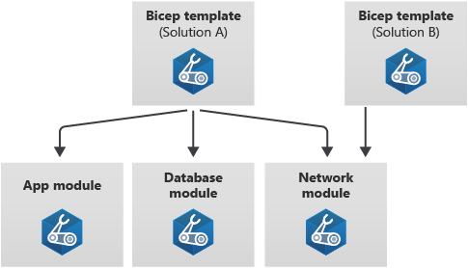
Modules
Use Modules to organize and reuse bicep
Create smaller units

Slide 28
Using Modules
Use another bicep file as module in this file
Filepathname
module myModule 'modules/mymodule.bicep' = { name: 'MyModule‘ params: { location: location } }
Parameters passed to
module

Slide 29
Some Tipps
Location from ressource can be retrieved (to e.g. put other resources in the same location)
Uniqueness of resrource names – you can generate an unique resource name with uniqueString()
param location string = resourceGroup().location
param storageAccountName string = uniqueString(resourceGroup().id)

Slide 30
STRING Interpolation
You can use String Interpolation within Bicep
param storageAccountName string = 'sqlbits${uniqueString(resourceGroup().id)}'

Slide 31

Demos

Slide 32


Frank Geisler frank_geisler@geislers.net @FrankGeisler
FEEDBACK

